Slide 1
Web Designing with HTML 5

Slide 2
What is HTML 5
New Standard proposed by W3C and WHATWG (Web Hypertext Application Technology Working Group)
Comes out to be more Powerful and Promising features compared to previous versions like HTML4 and XHTML
Proposed Standard**

Slide 3
New Features
Semantic Elements for Easy and Meaningful Designing of a web page
New Form elements and Input types
Canvas and SVG Support
Geolocation to keep track of everything
Stage Management
Offline Web Application
Threads
CSS3 Support

Slide 4
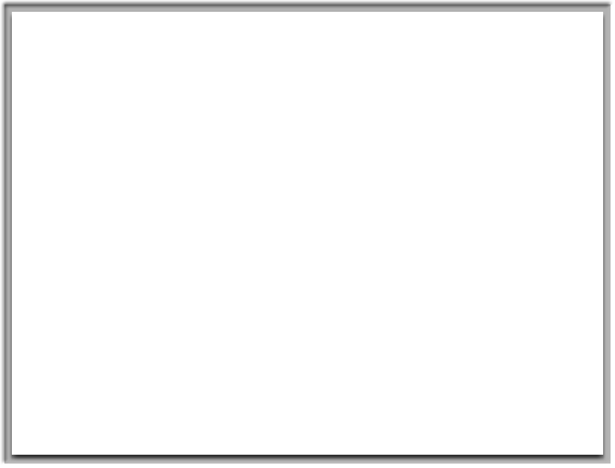
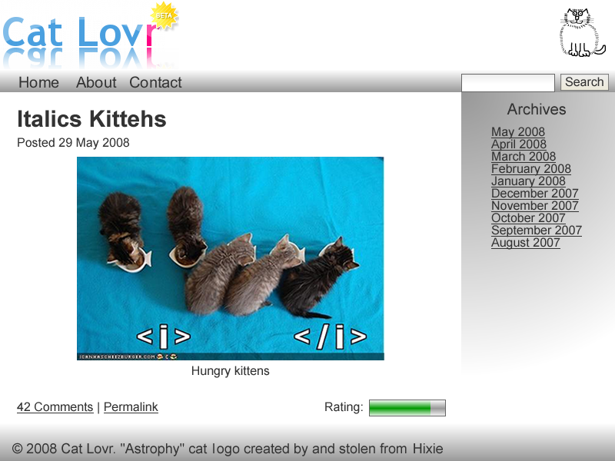

Slide 5
<header>
<nav>
<article>
<aside>
<footer>

Slide 6
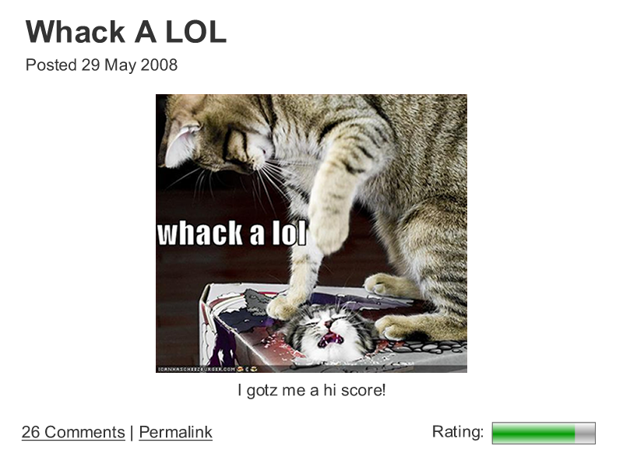
<time>
<figure>
<legend>
<meter>

Slide 7

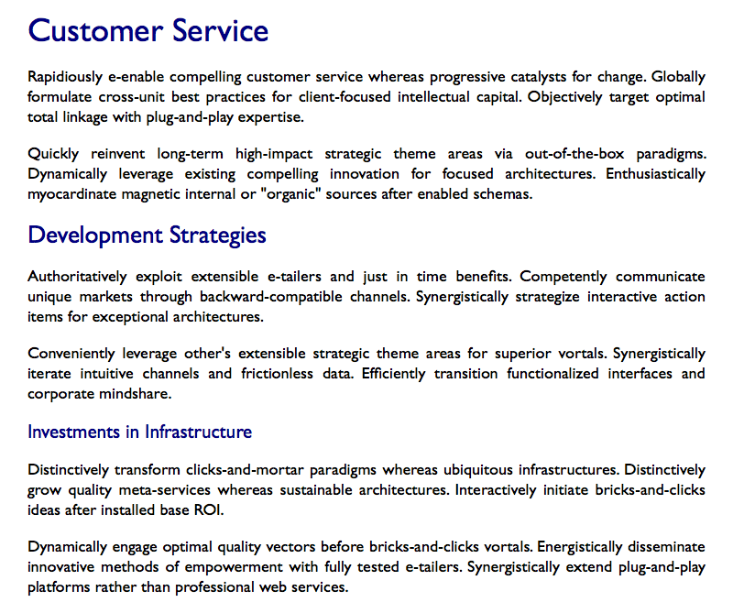
<h1>
<section>
<h1>
<h1>

Slide 8
Semantic Element
No more depend on DIV tag for the layout of your web page
Use meaning full new elements and attributes
This tags makes interpretations easy between browser and operating system
Note : Things would still work without this tags using certain techniques, but this tags are a straight solution

Slide 9
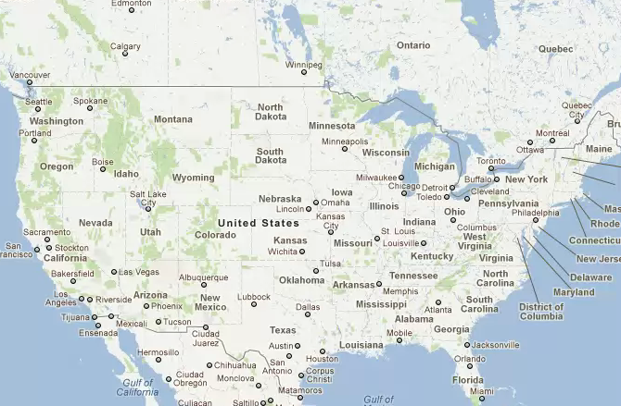
GeoLocation

Slide 10
latitude The latitude as a decimal number
longitude The longitude as a decimal number
accuracy The accuracy of position
altitude The altitude in meters above the mean sea level
altitudeAccuracy The altitude accuracy of position
heading The heading as degrees clockwise from North
speed The speed in meters per second
timestamp The date/time of the response

Slide 11
Exceptions / Errors
PERMISSION_DENIED
POSITION_UNAVAILABLE
TIMEOUT
UNKNOWN_ERROR

Slide 12
CANVAS
HTML 5 defines the <canvas> element as “a resolution-dependent bitmap canvas
which can be used for rendering graphs, game graphics, or other visual images
on the fly.” A canvas is a rectangle in your page where you can use JavaScript
to draw anything you want.

Slide 13
you can draw a canvas by setting the width and height of the canvas and
style for border

Slide 14
Steps
1. create ajavascript function within a head section
2. create a variable to get focus of the canvas useing getElementById
eg. var c = document.getElementById("b");
Note: Javascript is case scencetive and follows camel case
3. Get the context of the canvas useing getContext
eg. var context = c.getContext("2d");
Note : do not try 3d, it is not yet standardised
4. use cordinates for the shapes
(refer to the document canvas.doc for all shapes)
5. call the function on event of element

Slide 15
Local Storage
For persisting the data on the client machine, cookies were the only means

Slide 16
Cookies - Drawback
1. cookeies were transmitted with each HTTPrequest, there by slowing down the
speed and increasing the network traffic.
cookies were transmitted with each HTTPrequest, there by sending data in a
unencrypted format, *unless whole web appication is server on SSL

Slide 17
Cookies - Drawback
can persist max of 4kb per user and website, which was not enough in todays application
what if cookies are dis-abled !!!

Slide 18
A lot of storage space
Storage on the client side
that persists beyond a page refresh
And isn’t transmitted to the server
Can be Done Using the localstorage API

Slide 19
First line of the MENIFEST file will always be
CACHE MANIFEST
File is Divided into 3 sections
Explicit Section (Implicitly Default)
Fallback section
Online whitelist
Each Section has a header of its own name.

Slide 20
MENIFEST FILE
CACHE MENIFEST
/file1.html
/Design.css
NETWORK:
/tracking.cgi
FALLBACK:
Offline.html
http://www.w3schools.com/html5/tryhtml5_html_manifest.htm

Slide 21
SVG – V1.1
It’s a Scalar Vector Graphics
Renders Graphics in XML Format, this compatible with every display mode
Better option than canvas, as per W3C
Reason being consistent across platforms and dimensions.
High Quality rendering ability with Zoom Functionality.

Slide 22
Shapes
Rectangle <rect>
Circle <circle>
Ellipse <ellipse>
Line <line>
Polyline <polyline>
Polygon <polygon>
Path <path>

Slide 23
<svg xmlns="http://www.w3.org/2000/svg" version="1.1">
Rectangle
<rect width="300" height="100"
style="fill:rgb(0,0,255);stroke- width:1;stroke:rgb(0,0,0)"/>
Circle
<circle cx="100" cy="50" r="40" stroke="black"
stroke-width="2" fill="red"/>
Ellipse
<ellipse cx="300" cy="80" rx="100" ry="50"
style="fill:yellow;stroke:purple;stroke-width:2"/>
</svg>

Slide 24
Embeded SVC
Unlike Javascript, you can embed create a .svg file and use it in multiple pages of your website.
<embed src="circle1.svg" type="image/svg+xml" />
<object data="circle1.svg“ type="image/svg+xml"></object>

Slide 25
Web-Socket
Web Sockets is a next-generation bidirectional communication technology for web applications which operates over a single socket and is exposed via a JavaScript interface in HTML 5 compliant browsers.
Once you get a Web Socket connection with the web server, you can send data from browserand receive data from server to browser

Slide 26
WebScoket
Creating a web socket is very simple
Use the Socket api on the client side
var Socket = new WebSocket(url);
Here url is the address of the server

Slide 27
WebSocket Attributes
Attribute / Property | Value / Description
Socket.readyState | This is a read only property which represents the state of connection, returns the following value A value of 0 indicates that the connection has not yet been established. A value of 1 indicates that the connection has been established A value of 2 indicates that the connection has been established and a http handshare has been sucessful A value of 3 indicates that the connection has been closed sucesfully

Slide 28
Attribute
Attribute / Property | Description
Socket.bufferedAmount | The readonly attribute bufferedAmount represents the number of bytes of UTF-8 text that have been queued using send() method.

Slide 29
WebScoket - Events
Event | Event Handler | Description
open | Socket.onopen | This event occurs when socket connection is established.
message | Socket.onmessage | This event occurs when client receives data from server
error | Socket.onerror | This event occurs when there is any error in communication.
close | Socket.onclose | This event occurs when connection is closed

Slide 30
Web-Socket Methods
Attribute / Properties | Description
Socket.send() | The send(data) method transmits data using the connection.
Socket.close() | Terminates the connection from the server

